Slide 1


Cryptography
Enrique Velasco - CS 131

Slide 2

What is Cryptography?
A way to transfer and/or keep information safe from third parties other than the intended recipient
Hides the information and the person receiving can reveal the information through a process revealed by the sender

Slide 3
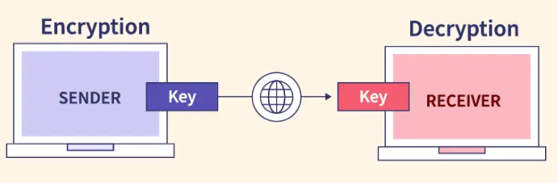
How Does Cryptography Work?
An algorithm/technique is used to encrypt information
The receiver of this encrypted information must know the encryption method or a “key” of some sort to decrypt the information
Many different methods that can be implemented to hide the information.

Slide 4
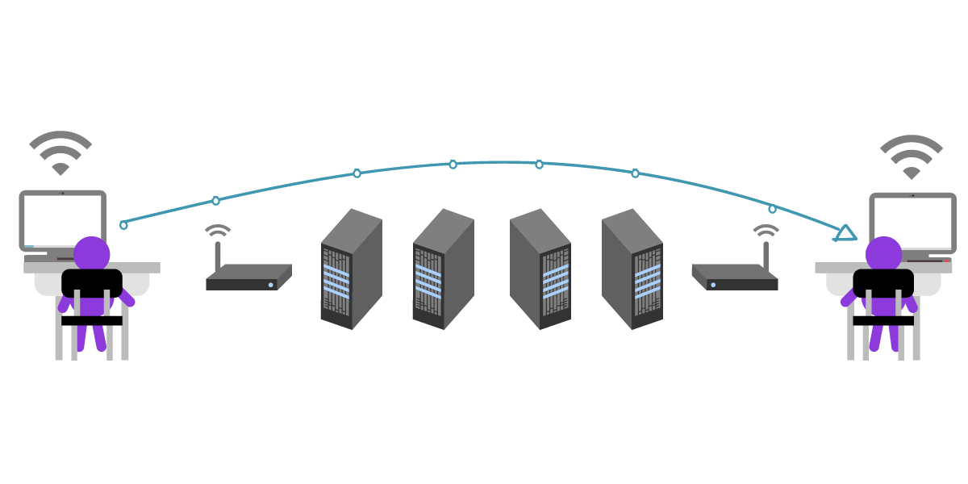
Why is Cryptography Important?
Ensures information is kept secretive between two parties
Disallows/makes it harder for third parties to read the information sent without the consent of the two parties
Makes it possible for information to be transferred on the internet

Slide 5



Common Uses of Cryptography
Payment systems on the internet use cryptography to safely get your credit/debit card information and properly charge you
Messaging applications secure your messages to ensure only the intended parties can read and send messages to each other
Virtual Private Networks use cryptography to ensure only you can connect to the network without anyone else eavesdropping

Slide 6
Early Forms of Cryptography

Slide 7
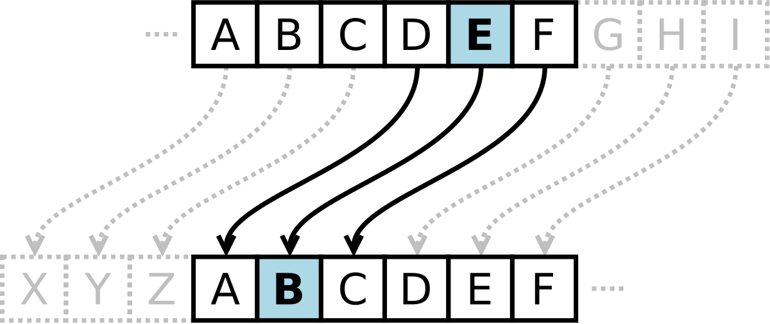
Caesar Cipher
A letter is replaced with another letter n places down/up the alphabet
For example, if n = 4, ‘a’ would be ‘e,’
“Hello World” with n = 5 would be “Mjqqt Btwqi”

Slide 8
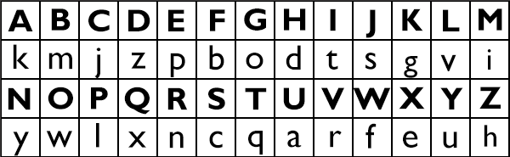
Substitution Cipher
Similar to the Caesar cipher where a letter is replaced with another letter, however, instead of a shift of n, a key/table is given
The letter can be reverted back using the table/key given to decrypt the message
For example, using the table below, “Hello World” would be “Dpvvw Fwnvz”

Slide 9
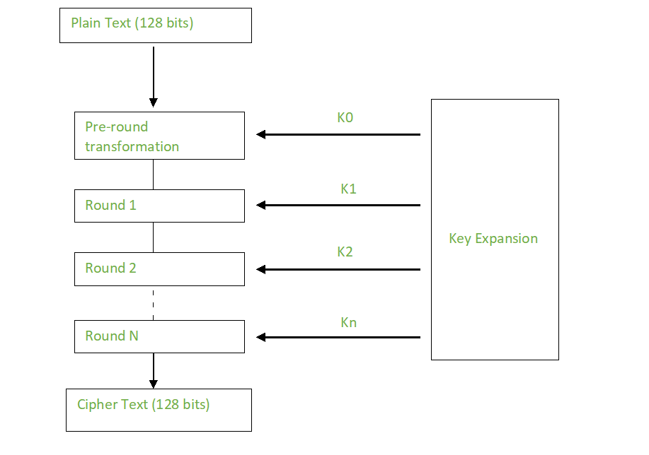
New Forms of Cryptography
Very sophisticated to write of, however, I can make a very simple summary of one example
Advanced Encryption Standard requires a key of set bits and expands it
Expansion requires different rounds of encryption depending on the bit size
These rounds include a combination of substitution and permutations to the data
The result is a cipher text

Slide 10
Is Cryptography 100% Secure?
It depends on which method you use
Newer methods can still be cracked, however, it would take even supercomputers MANY years to try and decrypt
Older methods can be easily cracked within seconds and even a few minutes by humans
We are still coming up with ways to make cryptography even more secure

Slide 11

End of Presentation
Thanks for watching my presentation on cryptography!

